Slide 1

Case Study 7
Unsupervised Learning
Trail&Ahead
Nafis Zafar

Slide 2
Objectives:
EDA (Exploratory Data Analysis
Data pre-processing: Missing value treatment, Outlier Check
Apply K Means Clustering: Apply K-means Clustering - Plot the Elbow curve - Check Silhouette Scores - Figure out appropriate number of clusters - Cluster Profiling
Applying Hierarchical clustering:
Hierarchical clustering, Dendrograms, cophenetic correlation, Cluster Profiling
K-Means vs Hierarchical Clustering
Actionable Insights ad recommendations

Slide 3
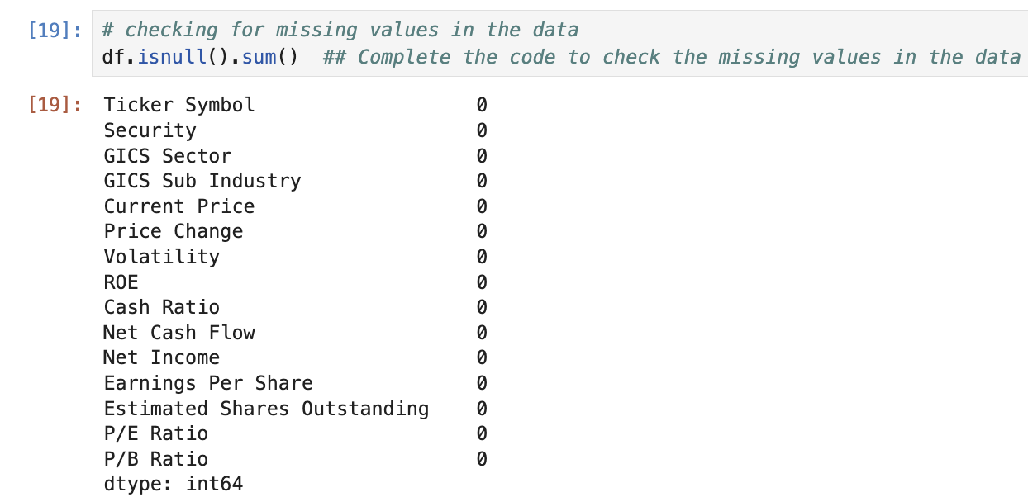
EDA (Exploratory Data Analysis)
There are 340 rows and 15 columns in the dataset
There are 4 non-numeric columns and 11 numeric/data columns
There are 0 duplicate values in the data set
There are no NULL values in the dataset

Slide 4
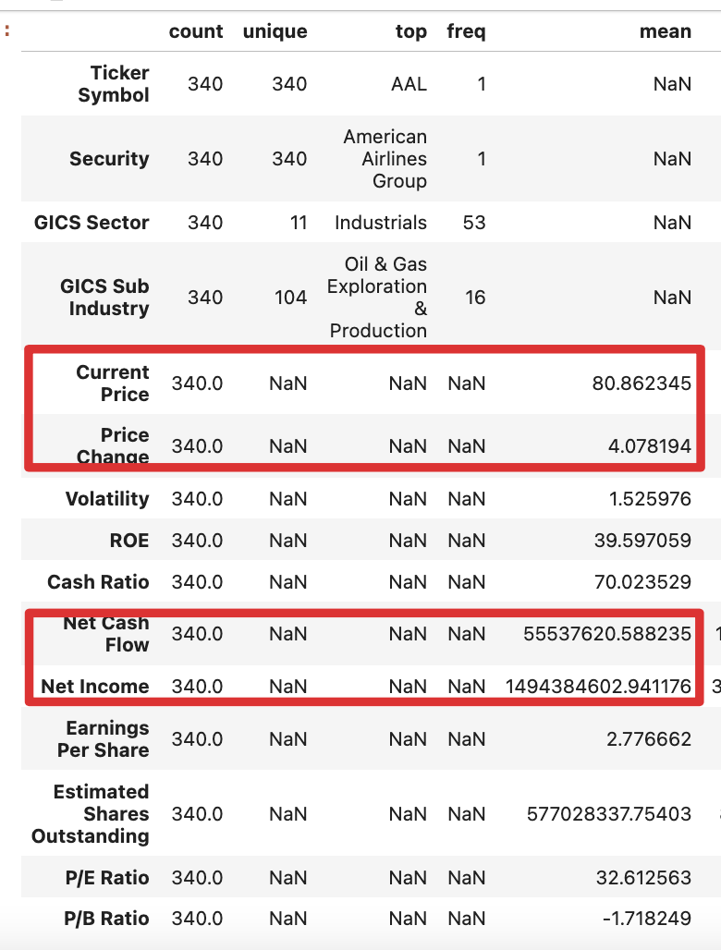
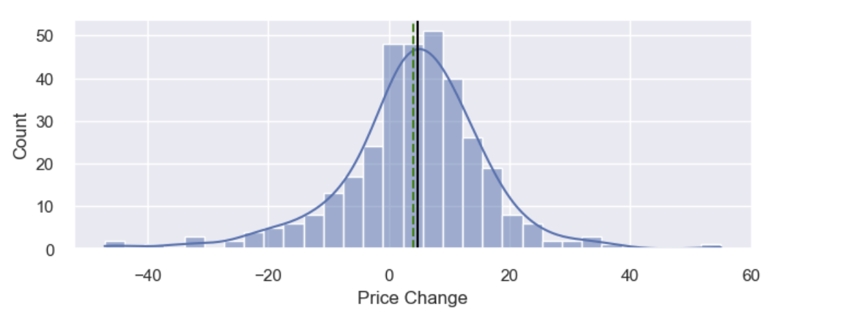
EDA (Exploratory Data Analysis)
The mean current price of stock is 80.86 and mean price change is 4.06
Net Cash Flow is 55537620.58 and Net Income of stocks is 1494384602.941

Slide 5
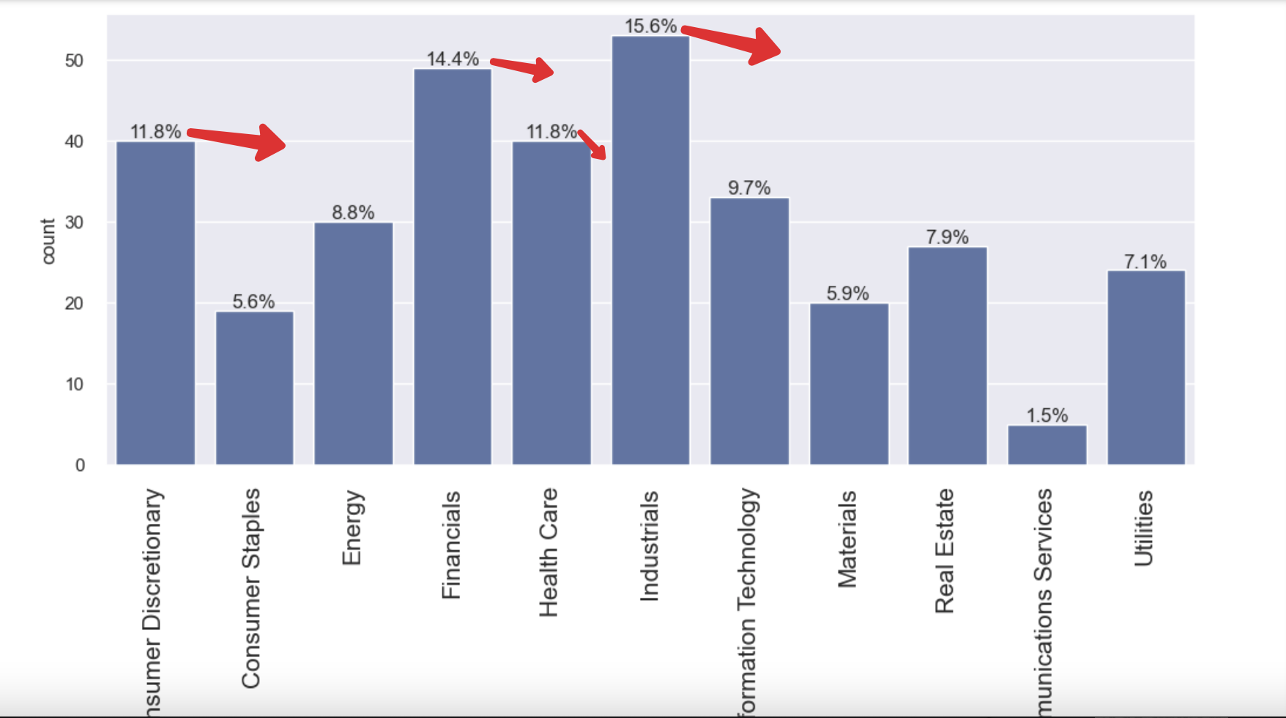
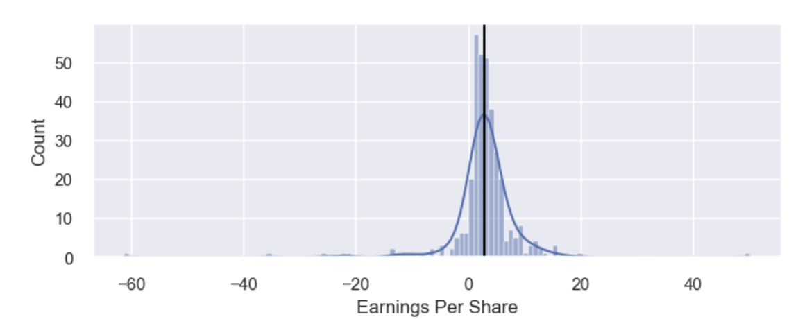
EDA (Exploratory Data Analysis)
The earning per share is a linear one while majority share earnings are between 0 and 10
The majority of the GICS Sector are within Financial, Healthcare, Industrials and Consumer Discretionary industries

Slide 6
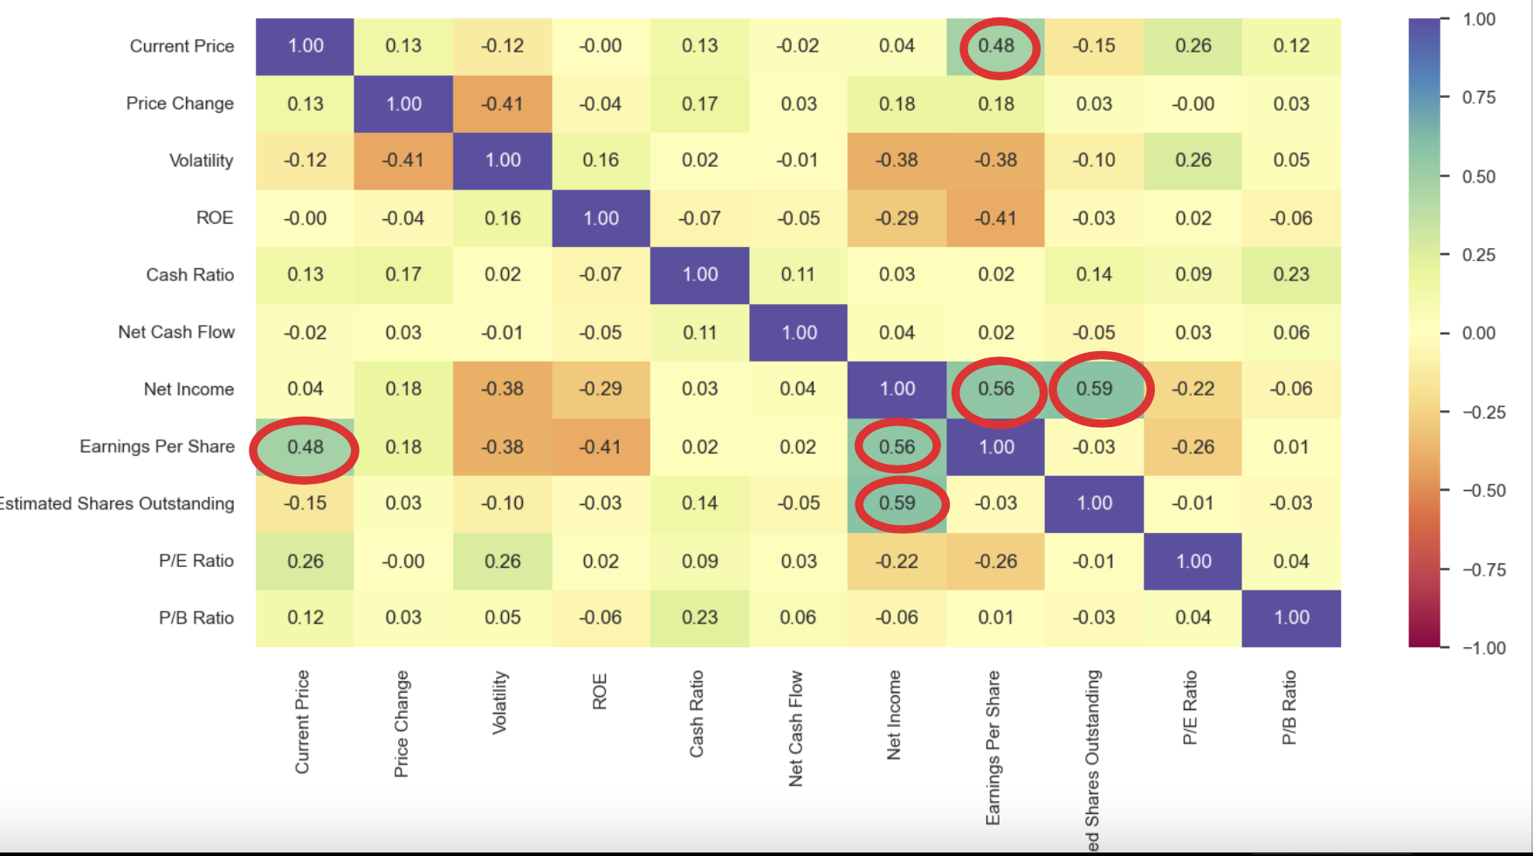
EDA (Exploratory Data Analysis)
We can see high correlation between Current Price and Earning, Outstanding Share and Net Income, Earning and Net Income.
We observed that except for Energy all GISC sectors have positive Price Increase.
IT sector has the highest Cash Ratio while Utilities sector has the lowest

Slide 7
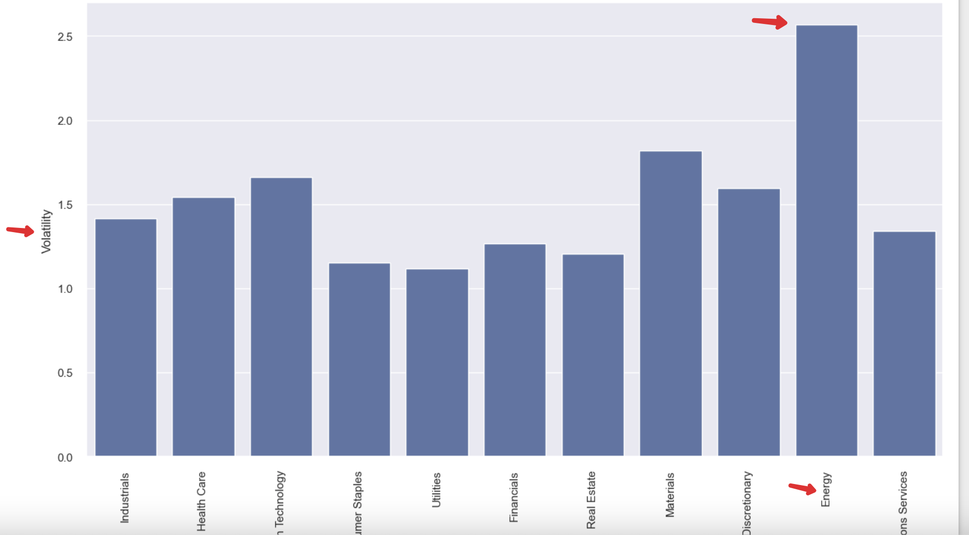
EDA (Exploratory Data Analysis)
Energy Sector has the highest PE Ratio and highest Volatility
Telecommunications Sector has lowest P/E Ratio
Utilities Sector has the lowest Volatility

Slide 8
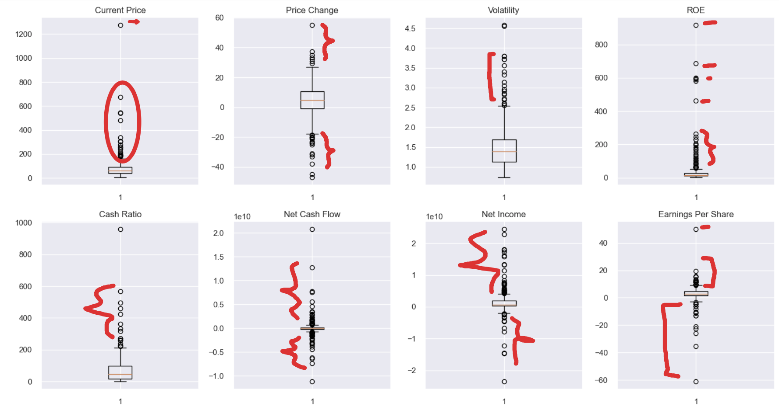
Data pre-processing: Missing value treatment, Outlier Check
The Dataset does not have missing values or NULL values
The Price of Shares averages 80 but we see some outlier values ranging from 200 to 700 and one extreme at 1200
Price Change, Net Cash Flow, Net Income and Earning have both positive and negative outliers

Slide 9
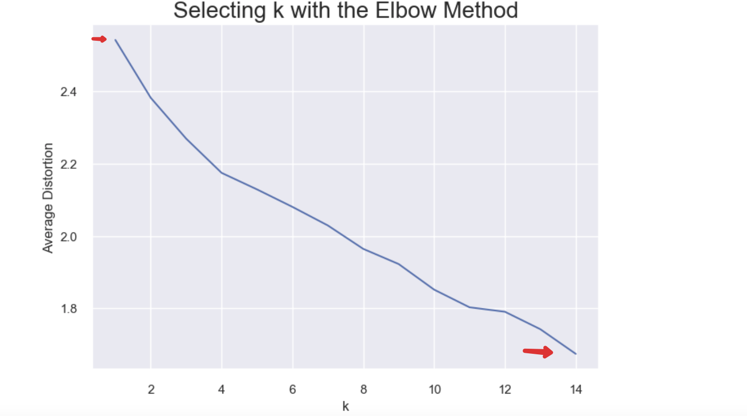
Apply K Means Clutering
We did 14 K-Means Clustering on the dataset
The avg distortion on 1 cluster is 2.54 and the for 14 clusters is 1.67

Slide 10
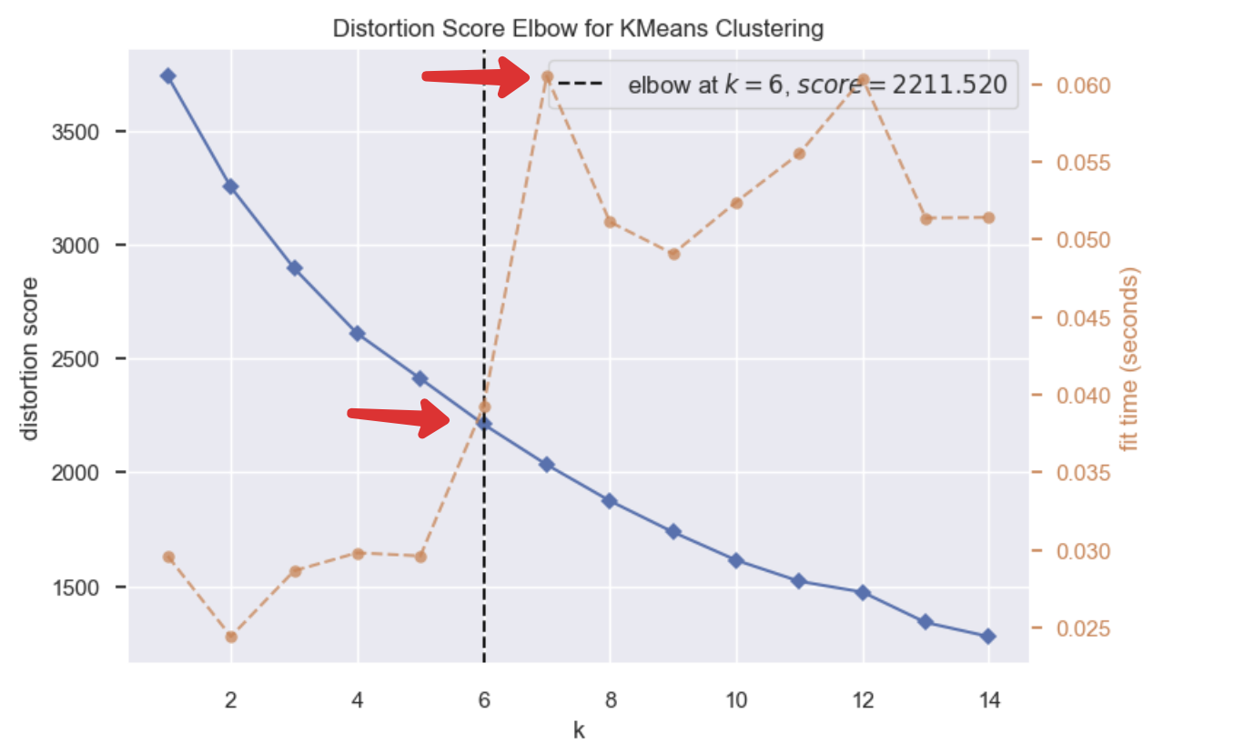
Apply K Means Clutering: Plot Elbow Curve
Elbow is at K=6 and score is 2210

Slide 11
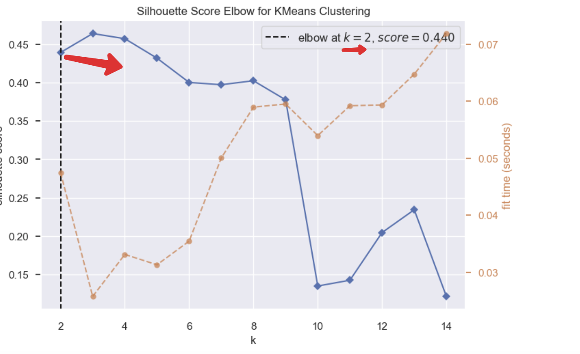
Check Silhouette Scores
For n_clusters = 2, the silhouette score is 0.43
For n_clusters = 14, the silhouette score is 0.12

Slide 12
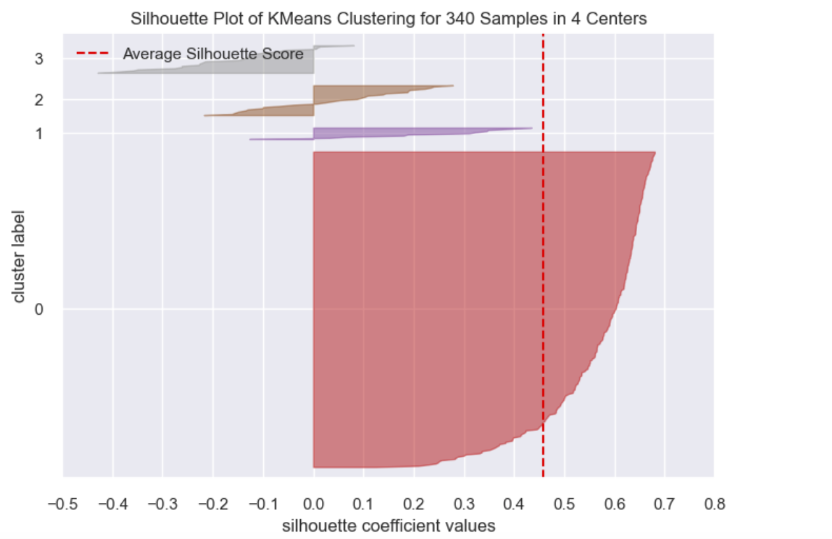
Plot of Silhouette Scores
Following is plot of Silhouette clustering for 340 samples in 4 centeres

Slide 13
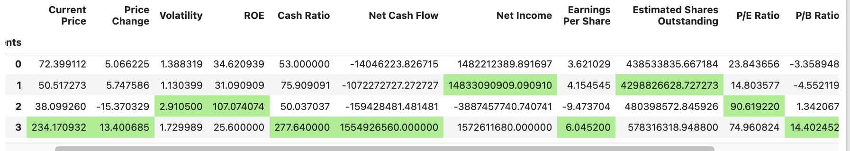
Cluster Profiling
Here are the scores of cluster profile by KM Segments 0 to 3
For Cash Price and Cash ratio segment 3 provides higher numbers
In cluster 1, the following companies are present: ['Citigroup Inc.' 'Ford Motor' 'Gilead Sciences' 'Intel Corp.' 'JPMorgan Chase & Co.' 'Coca Cola Company' 'Pfizer Inc.' 'AT&T Inc' 'Verizon Communications' 'Wells Fargo' 'Exxon Mobil Corp.']

Slide 14
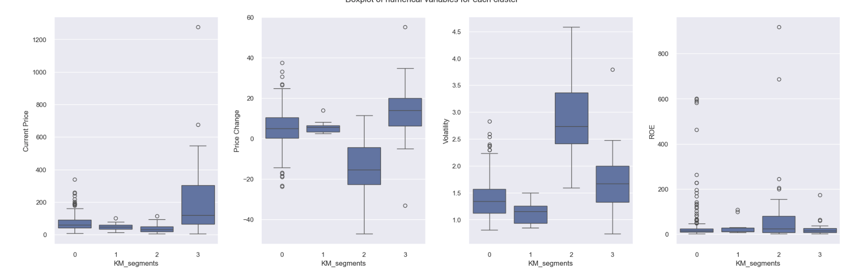
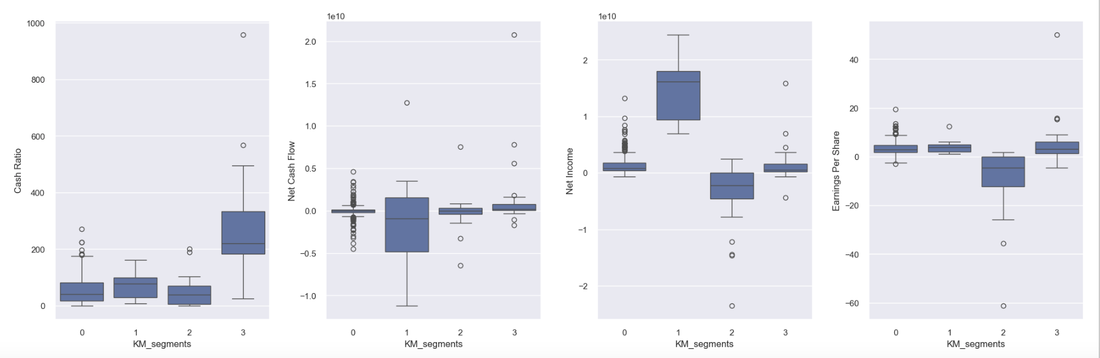
Boxplots of variables by Clusters

Slide 15
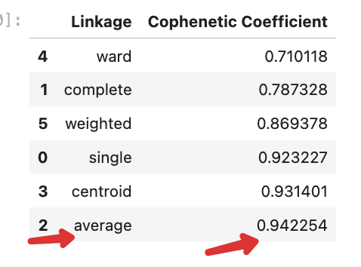
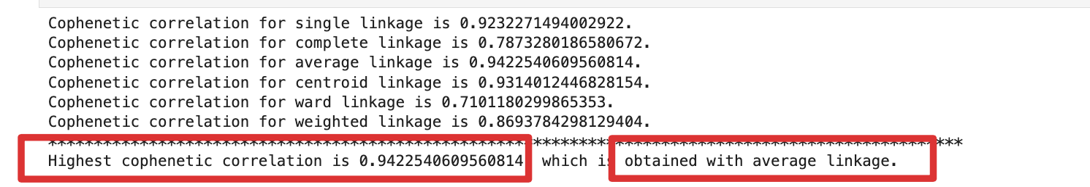
Apply hierarchical Clustering with different linkage method and apply dendrogram
By computing Cophenetic Correlation we see that Highest cophenetic correlation is 0.942, which is obtained with Euclidean distance and average linkage.
The cophenetic correlation is highest for average and average linkage methods.
We will move ahead with average linkage.
6 appears to be appropriate number of cluster

Slide 16
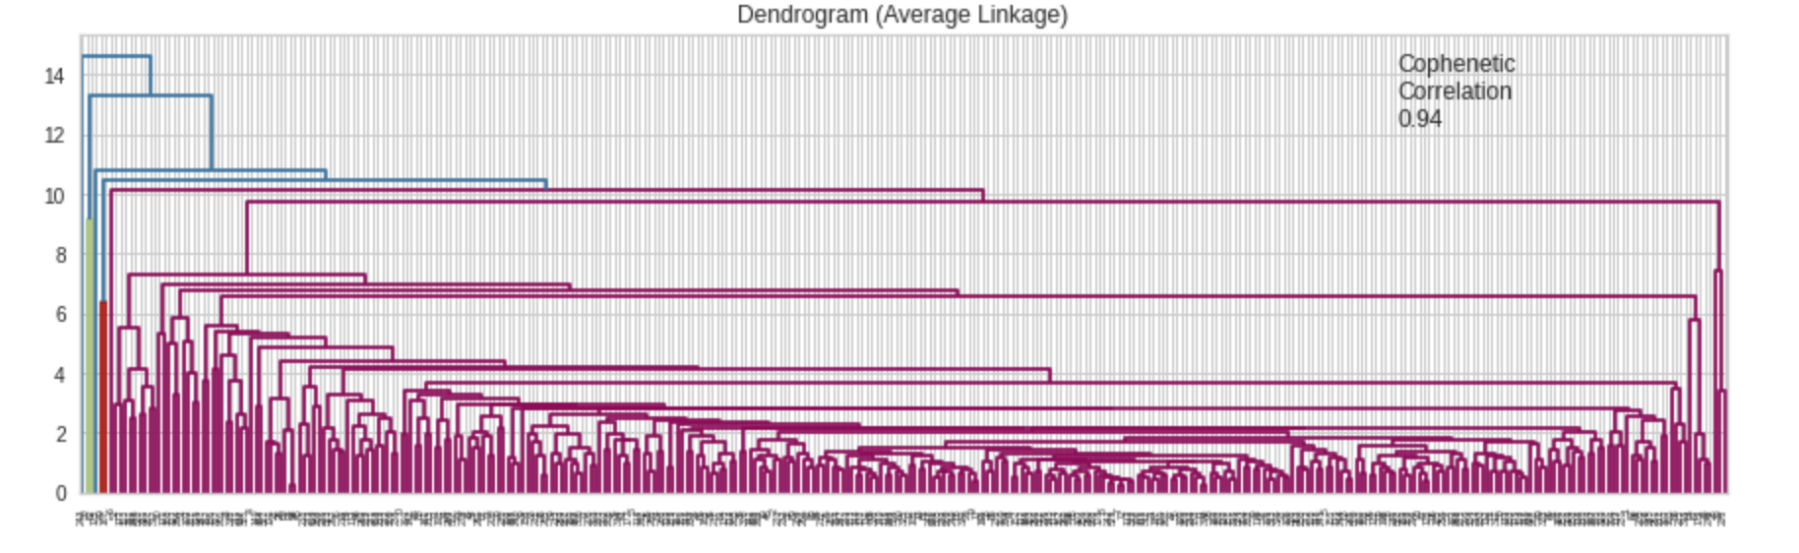
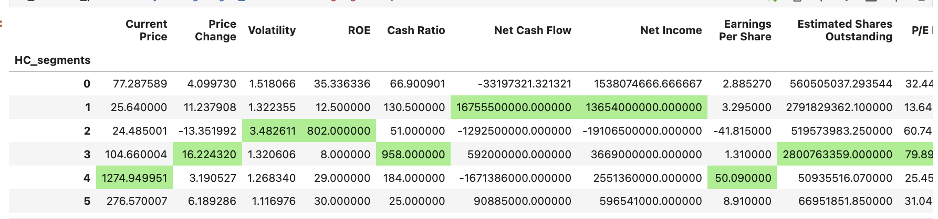
Figure out appropriate number of clusters - Cluster Profiling
Dendrogram with Average Linkage has highest Cophenetic correlation
Cluster Profile:

Slide 17
Figure out appropriate number of clusters - Cluster Profiling
Cluster Profile:
Cluster 2 has 330 companies which is the highest number. In this cluster P/B, P/E ratio and Cash Flow is low
Cluster 1 has only 2 companies ('Bank of America Corp' 'Intel Corp.’) that shows high cash flow and Net Earnings
Cluster 0 has 3 companies ('Alexion Pharmaceuticals' 'Amazon.com Inc' 'Netflix Inc.’) and it has high volatility and high P/E ratio

Slide 18
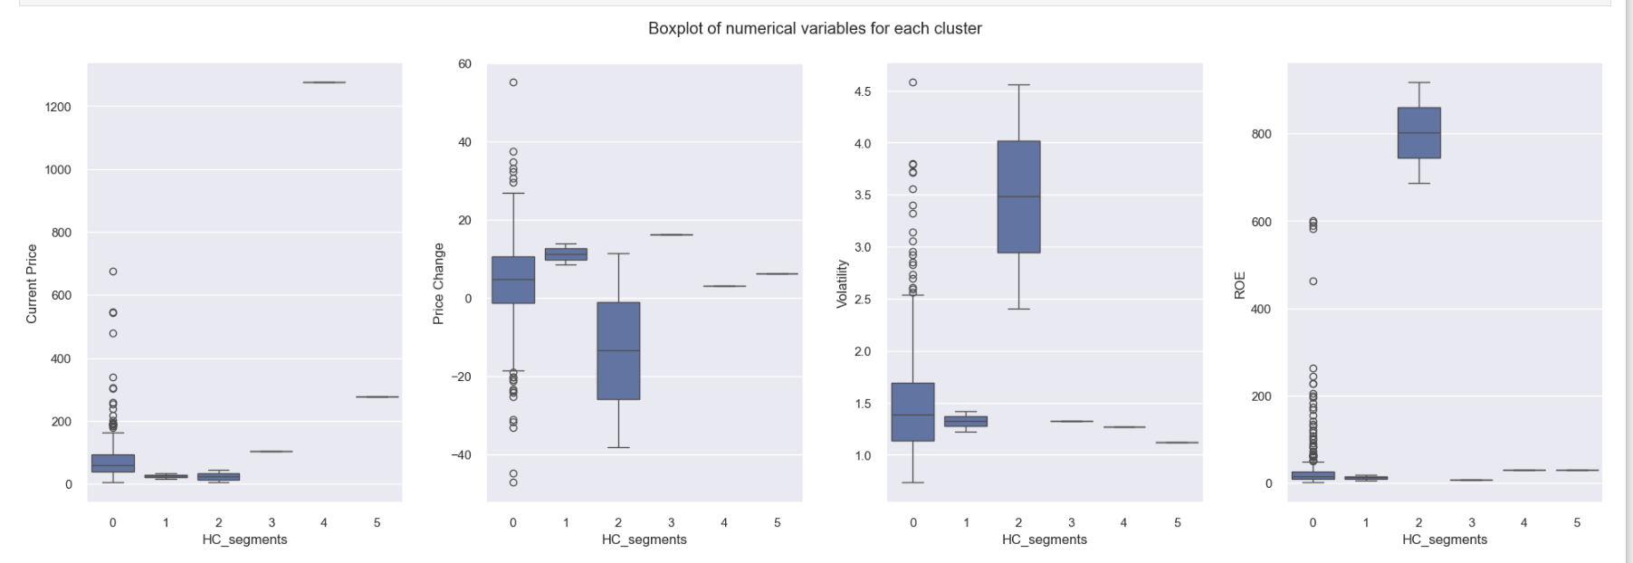
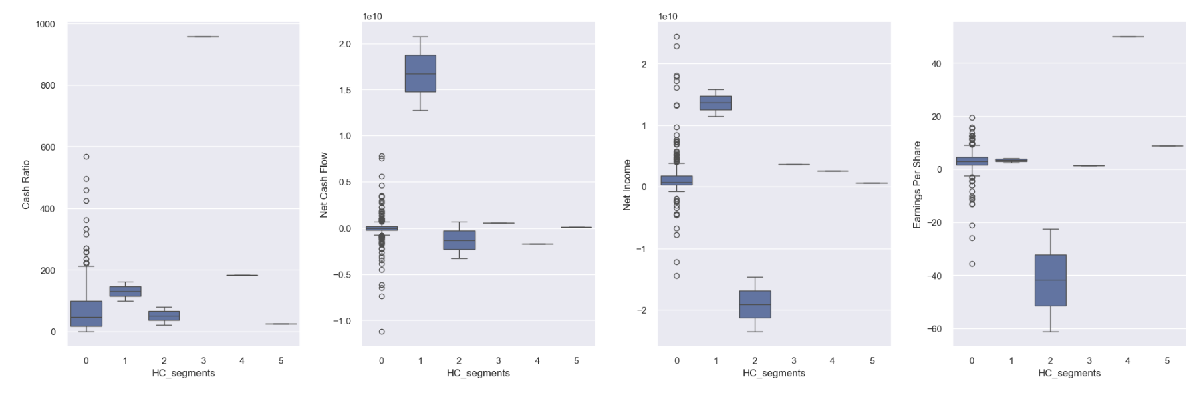
Figure out appropriate number of clusters - Cluster Profiling
Cluster Profile (Boxplot of variables by for all clusters)

Slide 19
K-means vs Hierarchical Clustering
K-Means Cluster took less execution time
Hierarchal clustering was able to provide better clustering
Hierarchical clustering has comparatively diverse and balanced clusters
Since data is in less amount hierarchical clustering can be preferred
But if data increases drastically then K-Means should be considered

Slide 20
Actionable Insights & Recommendations
Cluster 2 (in Hierarchical Clustering) has high volatile stocks. Also Earning Per Share is low and should be avoided for future purchase
Cluster 1 (in Hierarchical Clustering) has high Cash Ratio and Net Income. It should be prominent stock fir further purchase.

